Slide 1
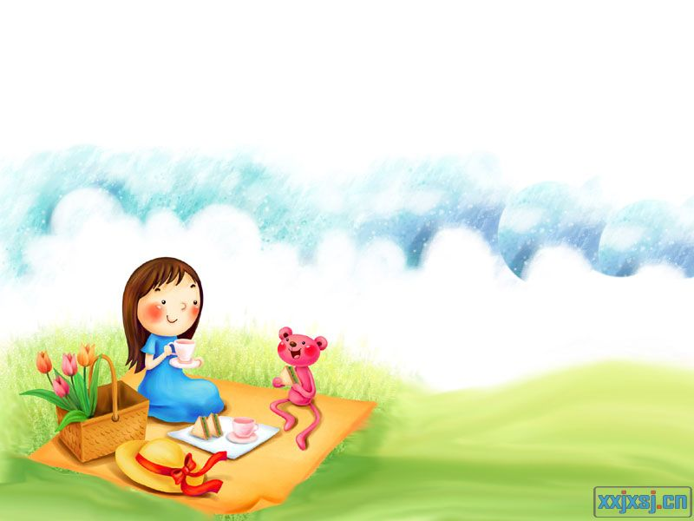
Unit 2 Let’s play sports !
Comic strip & welcome

Slide 2
Do you remember them?
Simon
Who likes sports?
What sport is Amy good at?
Swimming

Slide 3
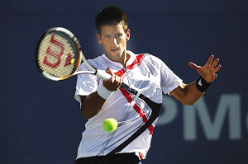
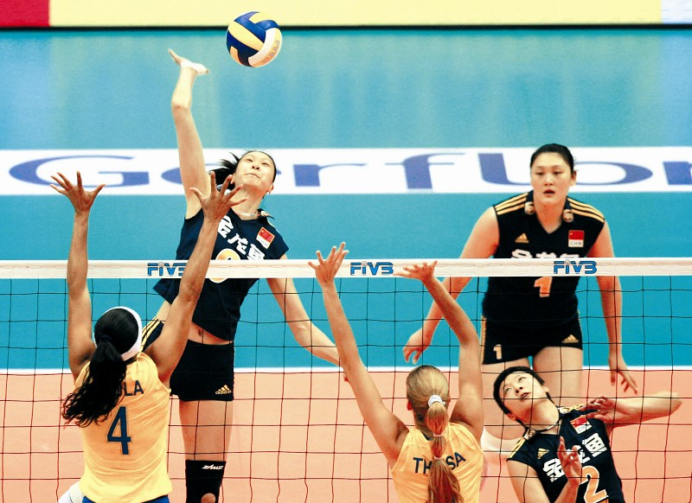
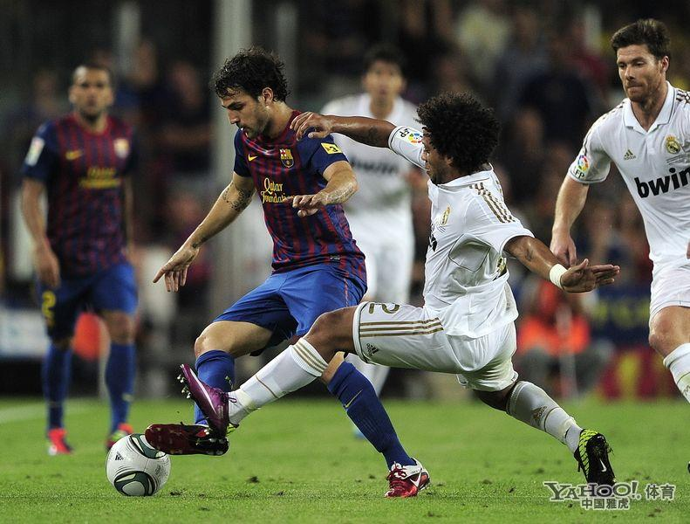
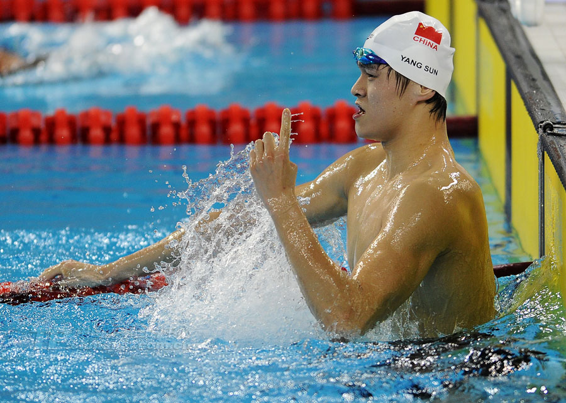
What is your favourite sport?
I like/love/am good at/enjoy…
tennis
volleyball
football
swimming

Slide 4
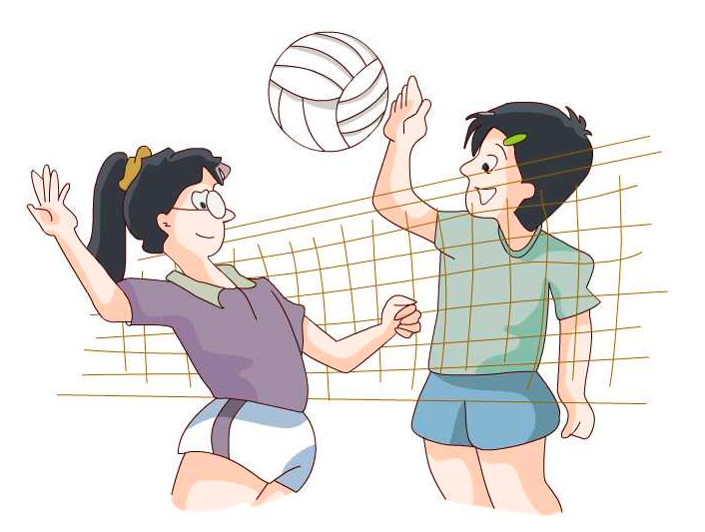
volleyball
playing volleyball
They like ___________________.

Slide 5
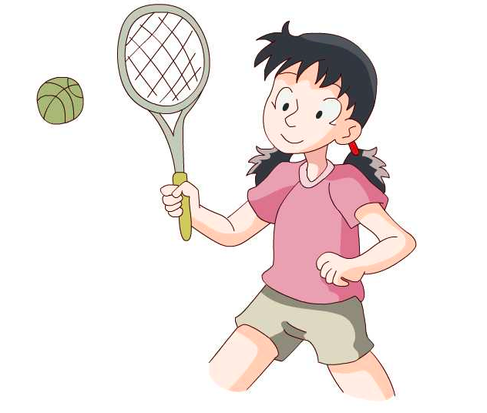
tennis
She is good at ___________________.
playing tennis

Slide 6
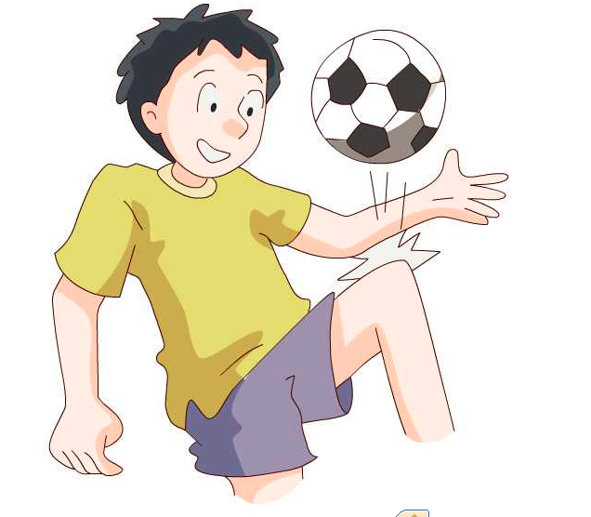
football
He loves ___________________.
playing football

Slide 7
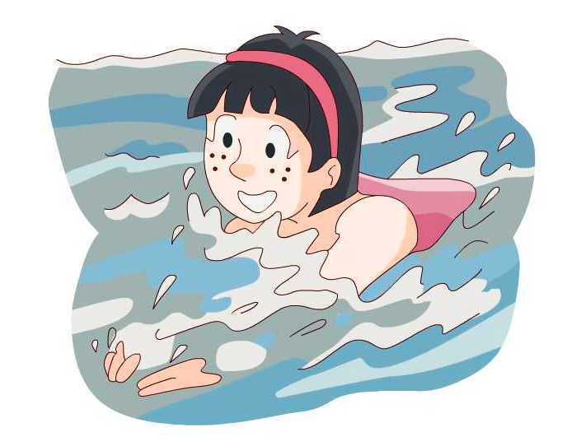
swimming
She enjoys ______________.
swimming

Slide 8
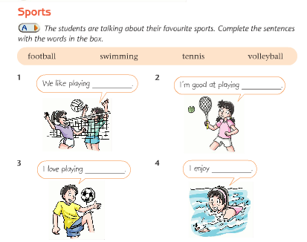

Slide 9
We like playing volleyball.
I’m good at playing tennis.
I love playing football.
I enjoy swimming.

Slide 10
Do you want to know other sports?

Slide 11
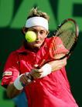
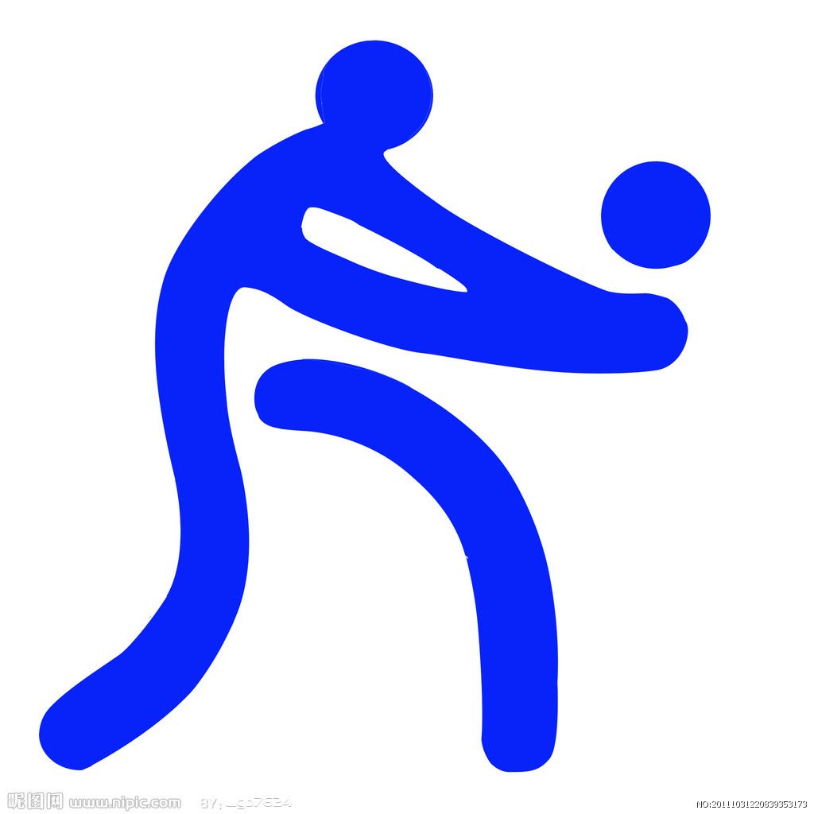
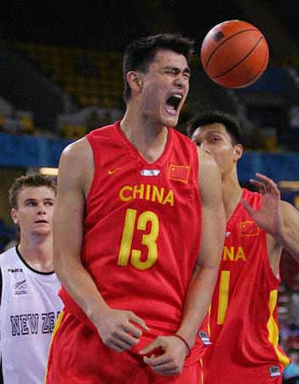
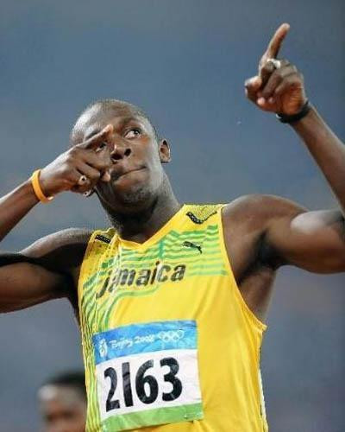
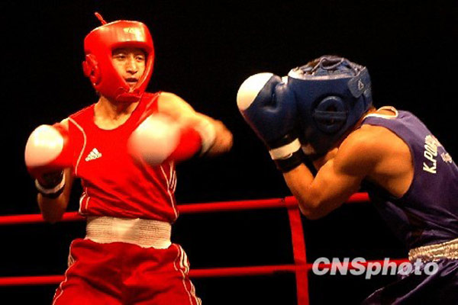
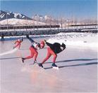
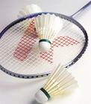
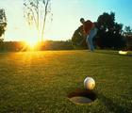
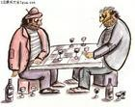
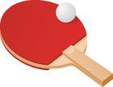
Game:
Match
basketball, football, volleyball, baseball, golf, swimming, tennis, table tennis, badminton, boxing, running, skiing, skating, shooting, chess

Slide 12
It is time for us to do more sports!
basketball, football, volleyball, baseball, golf, table tennis, tennis, badminton, chess
play
swimming, boxing, skating, running, skiing, skating, shooting
go

Slide 13
Eddie and Hobo are talking about sports too. Listen and answer the following questions:
Does Eddie like any sports?
What’s his favourite sport?
Does Eddie really like walking ?
What does he really like doing ?

Slide 15
Eddie and Hobo are talking about sports too. Listen and answer the following questions:
Does Eddie like any sports?
What’s his favourite sport?
Does Eddie really like walking ?
What does he really like doing ?
Yes, he does.
He likes walking.
No , he doesn’t.
He really likes eating.

Slide 16
How do you know ?
He walks to his bowl many times a day.
He walks to his bowl to eat many times a day.
翻译：
一年四次
four times a year
一月三次
three times a month
一周两次
twice a week
一天一次
once a day

Slide 17
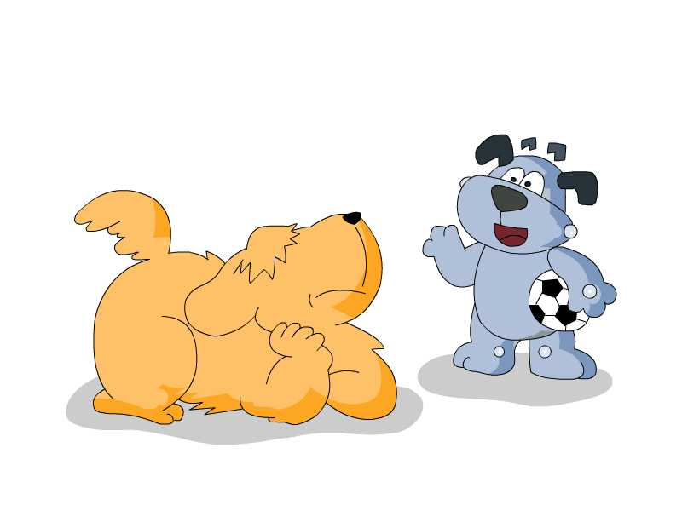
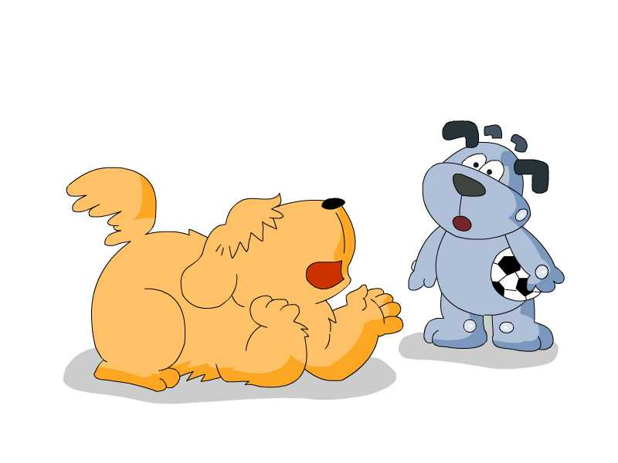
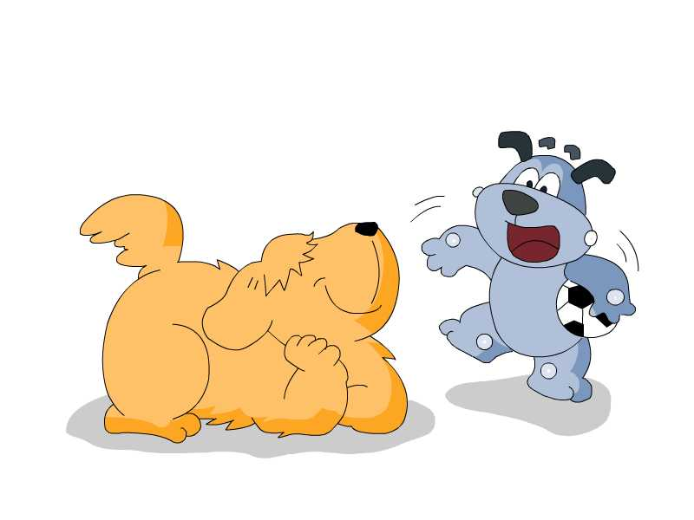
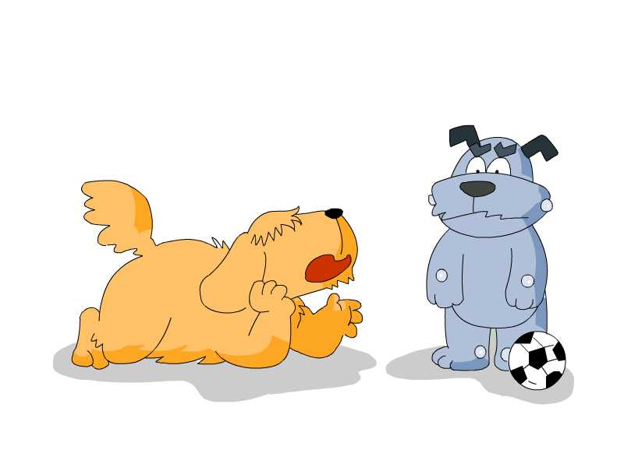
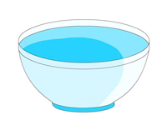
Act

Slide 18
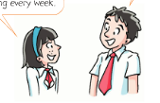

Slide 19
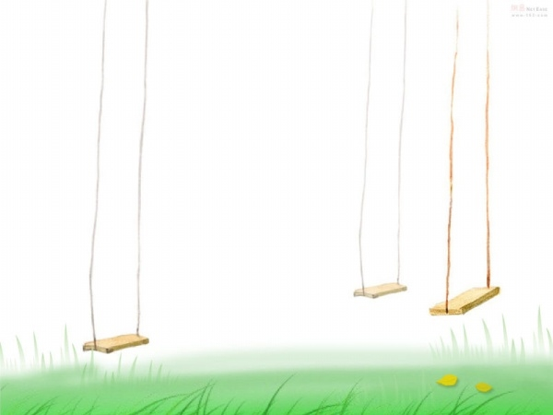
Amy and Simon's favourite sport
Listen to their dialogue and fill in blanks.
Amy likes _______. Simon likes
playing_____.He often plays it________.
Amy goes swimming_________.
Swimming
football
after school
every week

Slide 20
Make a dialogue
A:What’s your favourite sport?
B:_________________________
A:Do you often_______________?
B:Yes.
A:How often do you___________?
B:I_____________ ___________
A:Are you good at_____________?
B:____________________
(Who, where……)

Slide 21
I’m a reporter(记者). I want to know…Can you make a dialogue(对话)with your desk mate?
Speaking
What is your favourite sport?
Do you often …?
How often do you …?
Who is your favourite sports star?

Slide 22
Homework:
Recite the sports and phrases.
2. Finish the exercises.

